Slide 1
Day-3 Research Paper Writing and Journal Discovery using GPTs

Slide 2
Session11: AI as Research Assistant
AI is becoming a powerful companion in research, helping faculty and scholars save time and effort. Instead of spending hours searching, summarizing, and drafting, AI tools can assist at every stage of the research process from generating ideas to preparing a final draft.
However, there are also limitations. Some tools may produce inaccurate or fake citations, and over-reliance on AI can reduce critical thinking.
Popular tools include Scispace for summarizing research articles, Paperpal for academic writing improvement, Google Scholar for reference search, and DBLP for computer science bibliographies.
Learning Objective
Understand how AI tools can support the research process from idea generation to literature review, drafting, and journal discovery.

Slide 3
🧩 Icebreaker Question
❓ “If AI could save you 5 hours weekly in research, how would you use that time?” 👉 Discuss with your neighbor for 2 minutes.

Slide 4
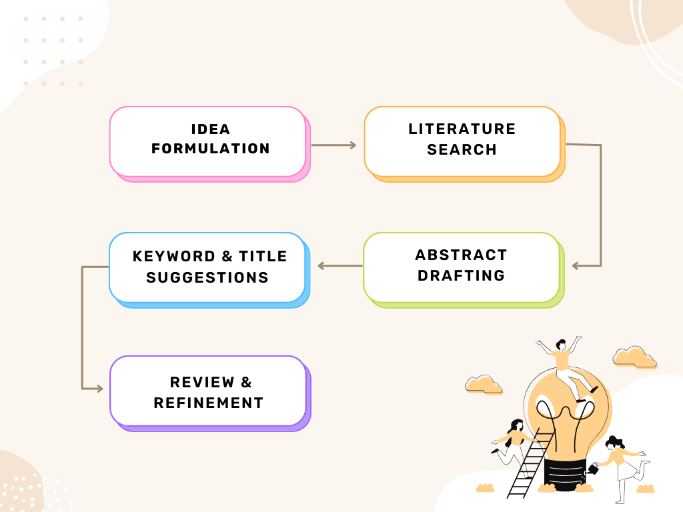
🔄 AI-Assisted Research Workflow

Slide 5
✅ Advantages vs ⚠️ Limitations
Advantages:
Saves time in drafting & Literature search.
Summarizes lengthy papers.
Improves clarity and language.
Limitations:
May generate inaccurate or fake citations.
Over-dependence risks loss of critical thinking.
Needs human validation before publishing.

Slide 6




🛠️ Tools for Research Assistance
Scispace – Summarizes and explains research papers.
Paperpal – AI – powered academic writing and grammar correction.
Google Scholar – Free academic search engine.
DBLP – Computer science research database.
Scholar GPT (personalized gpt) – Academic Journal Article Finder

Slide 7



Slide 8
Quiz-1
What is the biggest risk of relying too much on AI in research? a) Faster literature reviews b) Risk of plagiarism and fake citations c) Better keyword generation d) Improved writing flow
Answer: b) Risk of plagiarism and fake citations 🔎 Overuse of AI may lead to unoriginal content and hallucinated citations.

Slide 9
Quiz-2
Which of the following is NOT a benefit of using AI in research? a) Saves time in drafting papers b) Automatically validates all citations c) Summarizes lengthy research articles d) Improves clarity and grammar
Answer: b) Automatically validates all citations 🔎 AI can generate text, summaries, and keywords, but it cannot guarantee that citations are correct or valid.

Slide 10
Quiz-3
Which database is widely used for Computer Science bibliographies? a) DBLP b) Scopus c) Elsevier d) Paperpal
Answer: a) DBLP 🔎 DBLP is a well-known database for computer science publications and bibliographies.

Slide 11
Quiz-4
Which of these pairs is correctly matched with its primary function? a) Paperpal – Summarizing long papers b) DBLP – Academic writing assistance c) Scispace – Research paper explanation & summaries d) Google Scholar – Grammar and style correction
Answer: c) Scispace – Research paper explanation & summaries 🔎 Explanation: Scispace summarizes and explains research articles; Paperpal is for grammar improvement, DBLP is a bibliography database, Google Scholar is for literature search.

Slide 12
Quiz-5
Suppose you are working on “AI in Medical Imaging.” Which AI tool combination is MOST effective for early-stage research? a) Scispace + Google Scholar (to find and summarize relevant studies) b) Paperpal + DBLP (to refine grammar and get CS-specific bibliography) c) ZeroGPT + Quillbot (to humanize and paraphrase text) d) Elsevier Journal Finder + Springer Suggester (to select journals directly before literature review)
Answer: a) Scispace + Google Scholar (to find and summarize relevant studies) 🔎 Explanation: In the early stage, the focus is on finding and understanding prior work, so Scispace (summaries) + Scholar (search) is best. Journal finders come later.

Slide 13
Session 12 – Hands-on: Write Abstract, Title & Keywords using GPT
AI-generated abstracts and titles are often well-structured and grammatically polished, but they may lack the critical insights that come from a researcher’s own analysis. That’s why these drafts should be treated as starting points, not final outputs. Faculty can guide students to use AI for brainstorming and drafting, while ensuring that the final version reflects original contribution, domain-specific accuracy, and proper academic tone. This balanced use of AI makes the writing process faster, yet still authentic.
🎯 Learning Objective
To practice how AI/GPT tools can generate academic abstracts, titles, and keywords, and learn how to refine them ethically.

Slide 14
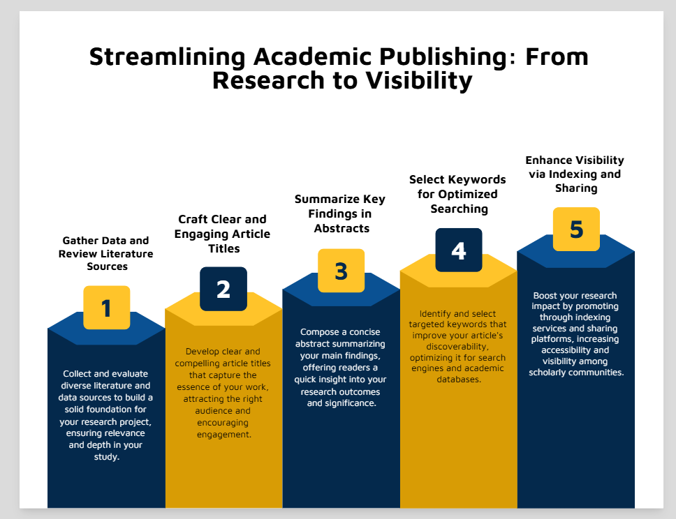
📌 Why Abstract, Title & Keywords Matter
Abstract → First impression; summarizes your entire research in 150–250 words.
Title → Must be clear, concise, and reflect core contribution.
Keywords → Ensure discoverability in databases (Google Scholar, Scopus, IEEE Xplore).

Slide 15
📑 How to Generate an Abstract with GPT
Input your topic + research objective.
👉 Example prompt: “Write a 200-word abstract for a paper on AI applications in precision agriculture.”
GPT generates a draft abstract.
Use Paperpal/Quillbot to refine language.
Validate facts & citations manually.

Slide 16
🏷️ Titles & Keywords
GPT can suggest multiple title options choose one that is short, specific, and impactful.
Ask GPT to generate 5-7 keywords.
👉 Example prompt: “Suggest 6 keywords for a paper on deep learning in medical imaging.”
Always cross-check: keywords should match standard indexing terms.

Slide 17

⚖️ Ethical Use & Caution
Do not copy-paste GPT outputs blindly.
Avoid plagiarism; check originality with plagiarism checkers. Use custom GPT - Turnitin AI - Plagiarism Detector GPT
Remember: AI assist but does not replace academic judgement.
Compare your writing summaries in your own words after reading each paper.
Follow the journal’s citation strictly.

Slide 19
Quiz-1
What is the main purpose of an abstract in a research paper? a) To provide keywords for indexing b) To summarize the entire paper in brief c) To list references used d) To make the paper look longer
Answer: b) To summarize the entire paper in brief 🔎 Explanation: Abstracts highlight objectives, methods, findings, and conclusions concisely.

Slide 20
Quiz-2
Which of these tools is BEST suited for checking AI-generated content score? a) Scispace b) ZeroGPT c) Paperpal d) Google Scholar
Answer: b) ZeroGPT 🔎 Explanation: ZeroGPT (or GPTZero) is designed to detect AI-generated text.

Slide 21
Quiz-3
When generating keywords using GPT, what should you ensure? a) They are very broad (e.g., “technology,” “science”) b) They match standard terms used in the research field c) They are unrelated to the abstract for variety d) They are at least 20 words long
Answer: b) They match standard terms used in the research field 🔎 Explanation: Keywords should reflect discipline-specific vocabulary for indexing in databases.

Slide 22
Quiz-4
Which step is MOST important after generating an abstract with GPT? a) Submitting it directly to a journal b) Humanizing and refining it for accuracy and originality c) Removing all technical details d) Replacing it with another AI-generated abstract
Answer: b) Humanizing and refining it for accuracy and originality 🔎 Explanation: AI drafts are starting points; final abstracts must be reviewed for originality and correctness.

Slide 23
Quiz-5
Which tool is primarily used for paraphrasing and refining AI-generated text? a) Quillbot b) DBLP c) Google Scholar d) Elsevier Journal Finder
Answer: a) Quillbot 🔎 Explanation: Quillbot is widely used to rephrase sentences and improve writing clarity.

Slide 24
Session 13 – Journal Discovery Tools (GPT + Elsevier + Springer)
This session focuses on how AI-powered tools like Elsevier Journal Finder, Springer Journal Suggester, and Google Scholar can guide researchers in selecting the most suitable journals for their manuscripts.
Correct journal selection ensures wider visibility, better audience reach, and higher chances of acceptance. Faculty will explore how to match their research scope with journal requirements, avoid predatory journals, and cross-check indexing for credibility. A hands-on exercise will help participants practice using these tools with their own abstracts.
🎯Learning Objective
To learn how AI-powered journal discovery tools help researchers find the right journals for their work, ensuring higher acceptance chances and wider visibility.

Slide 25




🛠️ Tools for Journal Discovery
Elsevier Journal Finder – Suggests journal based on title/abstract.
Springer Journal Suggester – Matches manuscript with Springer journals.
Google Scholar – Cross-checks scope & indexing.
GPT/Scispace – Quick suggestions, but must be verified with databases.
Scholar GPT – Academic Journal Article Finder

Slide 26
⚠️ Common Mistakes in Journal Selection
Points to overcome common mistakes
Choosing based only on impact factor.
Ignoring scope mismatch.
Not verifying predator journals.
Overlooking submission guidelines.
Check Journal Scope & Aim
Verify Journal Indexing & Reputation
Review Author Guidelines Carefully
Consider Journal Impact & Audience
Check Publication Timeline

Slide 27
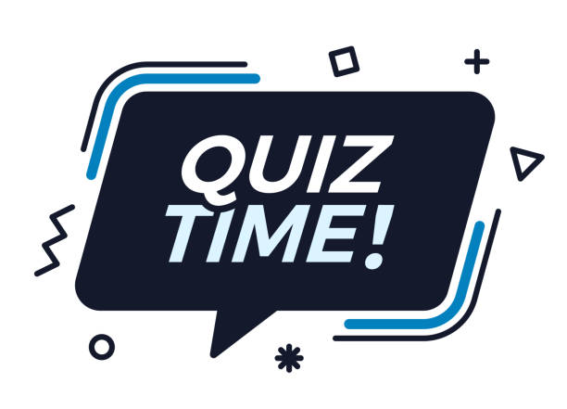

Slide 28
Quick Quiz: Match research topics to suitable journals using the given tools
🔬 Sample Research Topics for Quiz
“AI-Powered Early Diagnosis of Alzheimer’s Disease using Medical Imaging”.
“Optimization of Renewable Energy Grids using IoT and Machine Learning”.
“Blockchain Applications for Secure Supply Chain Management”.
“Big Data Analytics for Personalized Education Systems”.
“Nanomaterials for Efficient Water Purification”
Steps:
Run them through Elsevier Journal Finder / Springer Suggester.
Match with the best-fit journal based on scope & indexing.
Justify their choice.

Slide 29
Session 14 – GPT-Powered Literature Review
This session explores how AI tools like GPT, Scispace, and Google Scholar can speed up the literature review process by summarizing papers, suggesting citations, and highlighting research gaps. Faculty will learn how to generate structured reviews with proper formatting while ensuring originality through paraphrasing and plagiarism checks. The focus is on using AI as a supportive assistant, not a replacement for critical academic judgment.
🎯 Objective
To learn how GPT and AI tools can assist in creating structured literature reviews with proper citations, while avoiding plagiarism and ensuring originality.

Slide 30
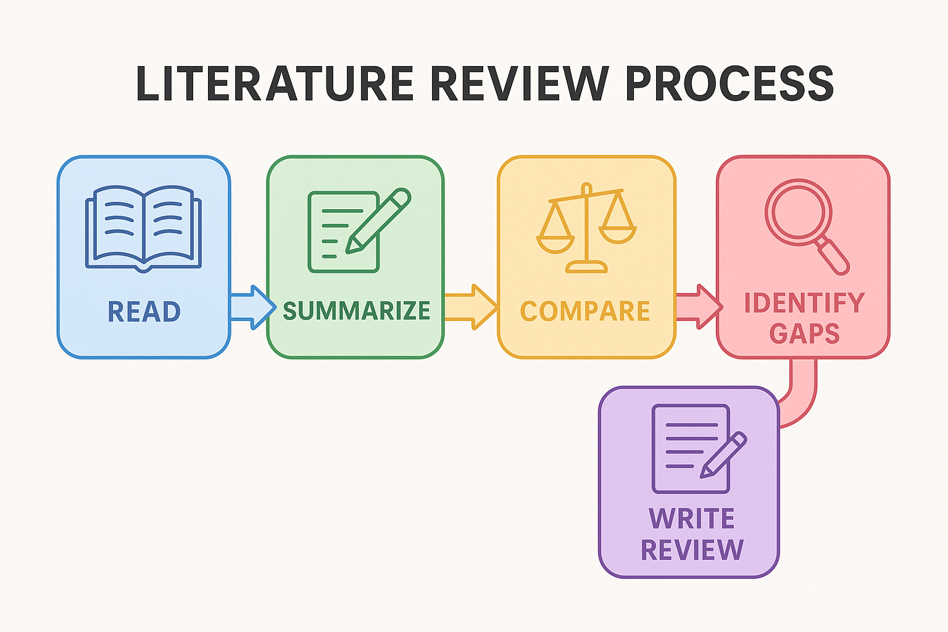
📌 What is a Literature Review?
A summary and synthesis of existing research on a topic.
Identifies gaps, trends, and limitations in prior studies.
Provides the foundation for new research.

Slide 31
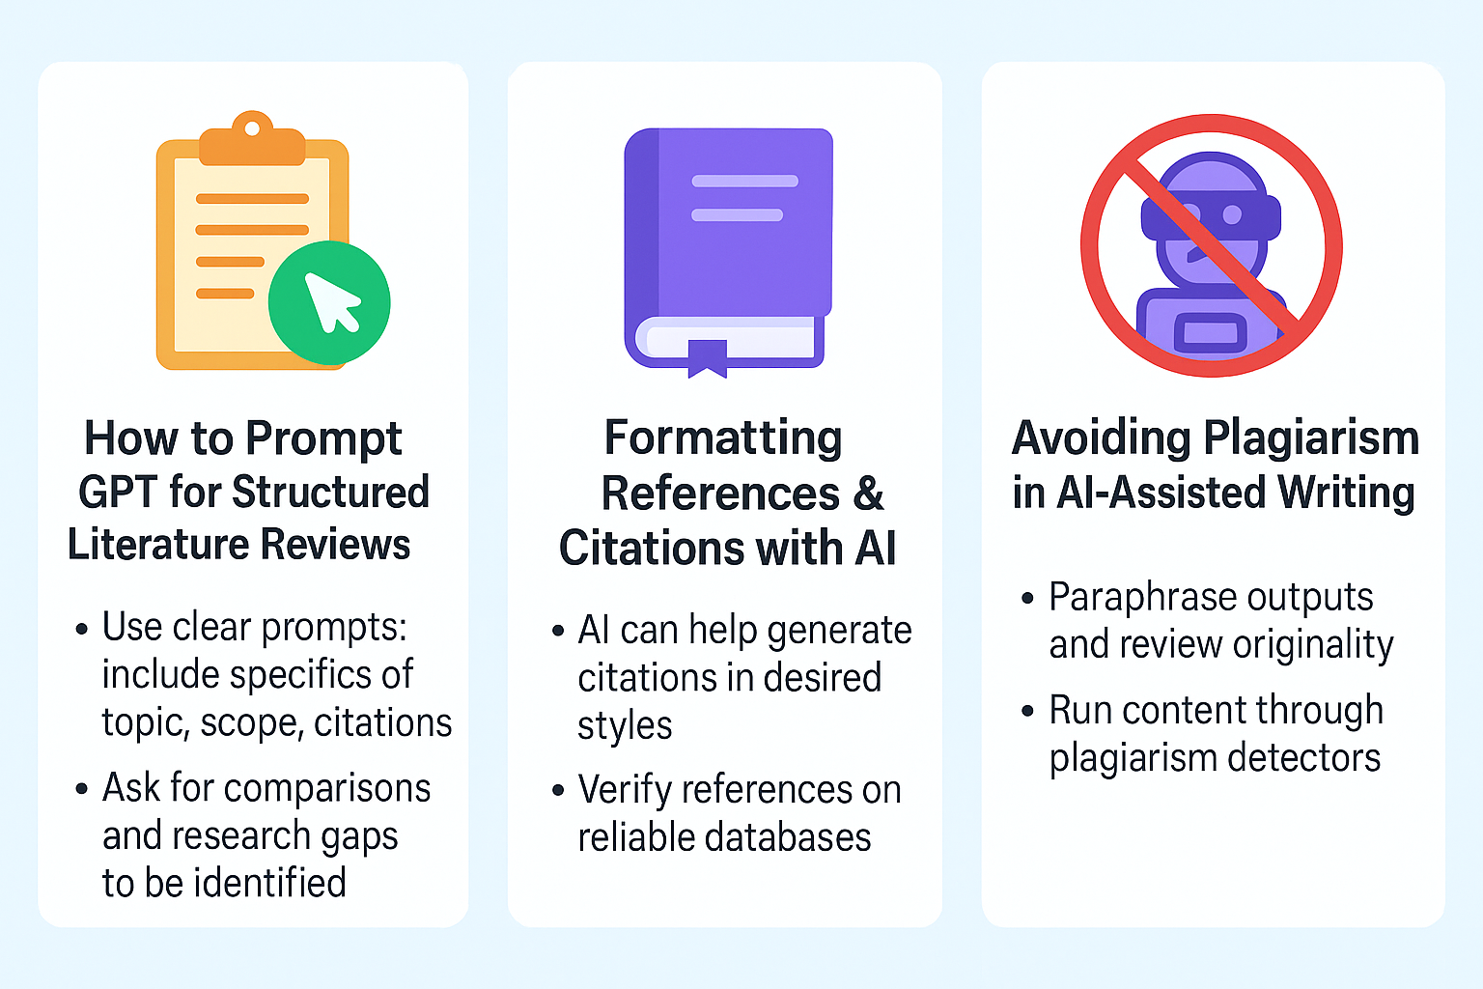
Prompt GPT, Formatting and Avoid Plagiarism

Slide 33
Quiz-1
What is the main purpose of a literature review in research? a) To present new experimental results b) To summarize and analyze existing research c) To list all references available on a topic d) To finalize the conclusion of the study
Answer: b) To summarize and analyze existing research 🔎 A literature review connects past studies, identifies trends, and shows research gaps not new results.

Slide 34
Quiz-2
Which tool is BEST suited for summarizing and explaining research papers? a) Google Scholar b) Scispace c) Quillbot d) ZeroGPT
Answer: b) Scispace 🔎 Scispace is designed for summarizing, explaining, and simplifying research papers.

Slide 35
Quiz-3
Why must citations generated by GPT always be verified? a) Because GPT sometimes fabricates or mixes up references b) Because GPT does not format citations c) Because citations are unnecessary in literature reviews d) Because GPT only generates keywords, not citations
Answer: a) Because GPT sometimes fabricates or mixes up references 🔎 GPT can create “fake citations” (hallucinations), so every citation must be cross-checked with Google Scholar / DBLP.

Slide 36
Quiz-4
Which tool is MOST suitable for paraphrasing and improving academic tone in a literature review? a) Scispace b) Paperpal / Quillbot c) DBLP d) Elsevier Journal Finder
Answer: b) Paperpal / Quillbot 🔎 Both tools are widely used for paraphrasing, improving grammar, and refining academic writing style.

Slide 37
Quiz-5
After drafting a literature review with GPT, what is the final step before submission? a) Check originality and plagiarism with tools like Turnitin or ZeroGPT b) Delete all references and rewrite manually c) Add unrelated citations to increase length d) Submit without any changes
Answer: a) Check originality and plagiarism with tools like Turnitin or ZeroGPT 🔎 This ensures the review is original, properly paraphrased, and safe from plagiarism issues.

Slide 38
Session 15: Research Mini-Project & Feedback Time to combine everything we learned today!
Apply AI tools for a complete mini-research package.
Practice generating abstract, keywords, journal suggestions, and literature review.
Engage in peer review and feedback to improve quality.

Slide 39
Mini-Project Task
👉 Each participant will create:
Abstract for chosen research topic.
3 Journal Suggestions (Elsevier / Springer / Scholar).
Mini Literature Review (GPT + citation tools).

Slide 40
Closing Note
🌟 Summary
Explored how AI assists in research writing & journal discovery.
Practiced generating abstracts, titles, keywords, and literature reviews.
Learned to use Scispace, Paperpal, Quillbot, ZeroGPT, Elsevier & Springer tools.
Applied knowledge in a mini-project and improved work through peer feedback.
💡 Key Takeaway
AI is your research assistant, not your replacement. Use it to save time, improve clarity, and discover opportunities but always validate with your own expertise.
📝 Quote to End the Day
“AI won’t replace researchers but researchers who use AI wisely will replace those who don’t.”

